Slide 1
M3

Slide 2
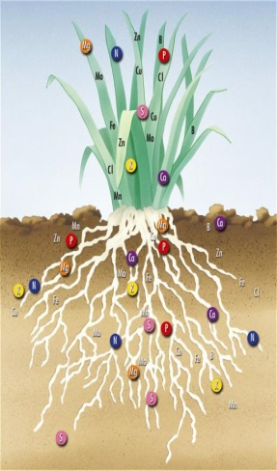
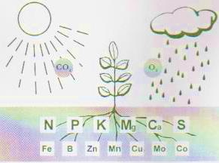
Crop Production Management :
It involves different steps like
1. Nutrient management :
Just as we need food for development, growth and well-being, plants also require nutrients for growth.
Nutrients are supplied to plants by air, water and soil.
There are sixteen nutrients which are essential for plants.
Air supplies carbon and oxygen.
Water supplies hydrogen.
Soil supplies the remaining thirteen nutrients.

Slide 3
These 13 nutrients are classified as :
Macronutrients
Micronutrients
Required in large quantities.
Required in small quantities.
Nitrogen, phosphorus, potassium, calcium, magnesium, sulphur.
Iron, manganese, boron, zinc, copper, molybdenum and chlorine.
Deficiency of these nutrients affects reproduction, growth and susceptibility to diseases.

Slide 4
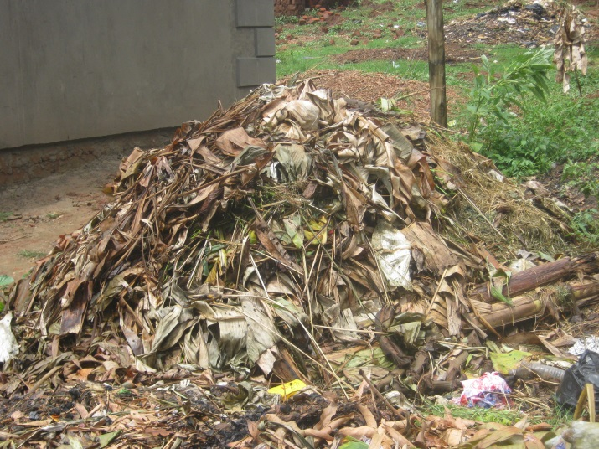
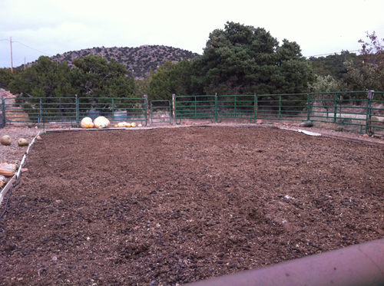
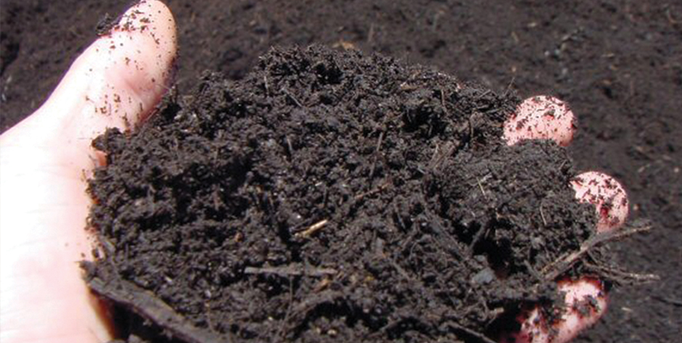
Manure :
Manure is prepared by the decomposition of animal excreta and plant waste.
Manure contains large quantities of organic matter and also supplies small quantities of nutrients to the soil.
Matter rich in organic compounds rich in nutrients
It also helps in improving the soil structure and water holding capacity of the soil.
Manure also helps in protecting our environment from excessive use of fertilizers and it is also a way of recycling farm waste.
Based on the kind of biological material used, manure can be classified as:

Slide 5
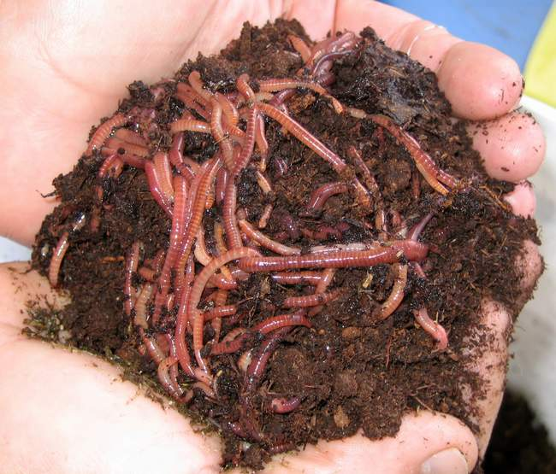
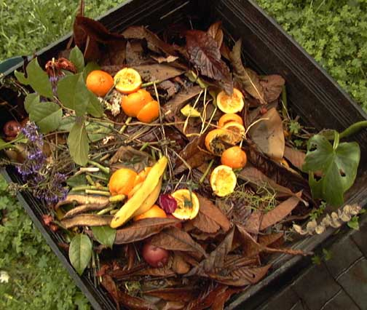
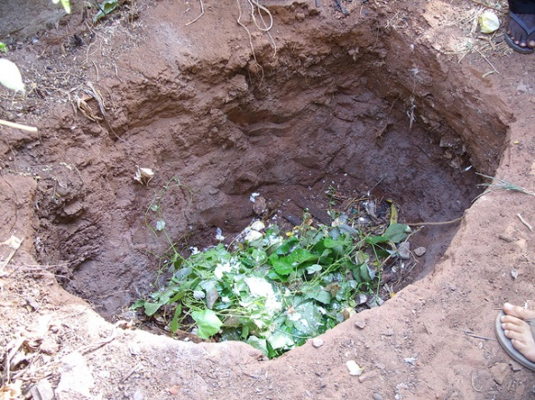
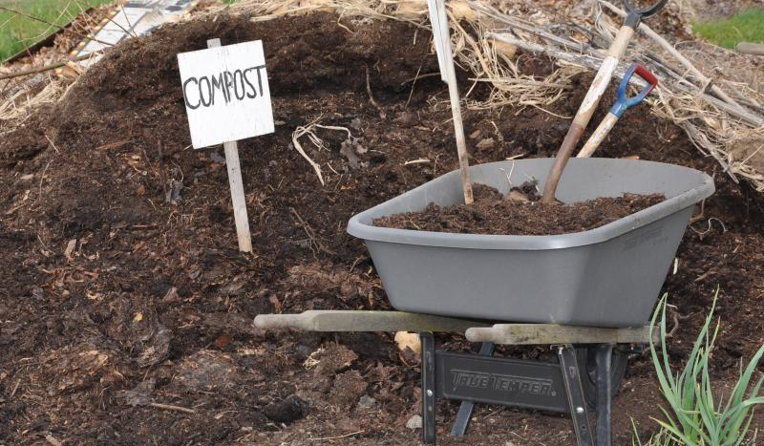
Manure :
Compost and vermi-compost :
The process in which farm waste material like livestock excreta, vegetable waste, animal refuse, domestic waste, sewage waste, straw, eradicated weeds, etc. is decomposed in pits is known as composting.
Cow-dung
Unwanted plants removed from the fields.
The compost is rich in organic matter and nutrients.
Compost is also prepared by using earthworm to fasten the process of decomposition of plant and animal refuse.
This is called vermi-compost.

Slide 6
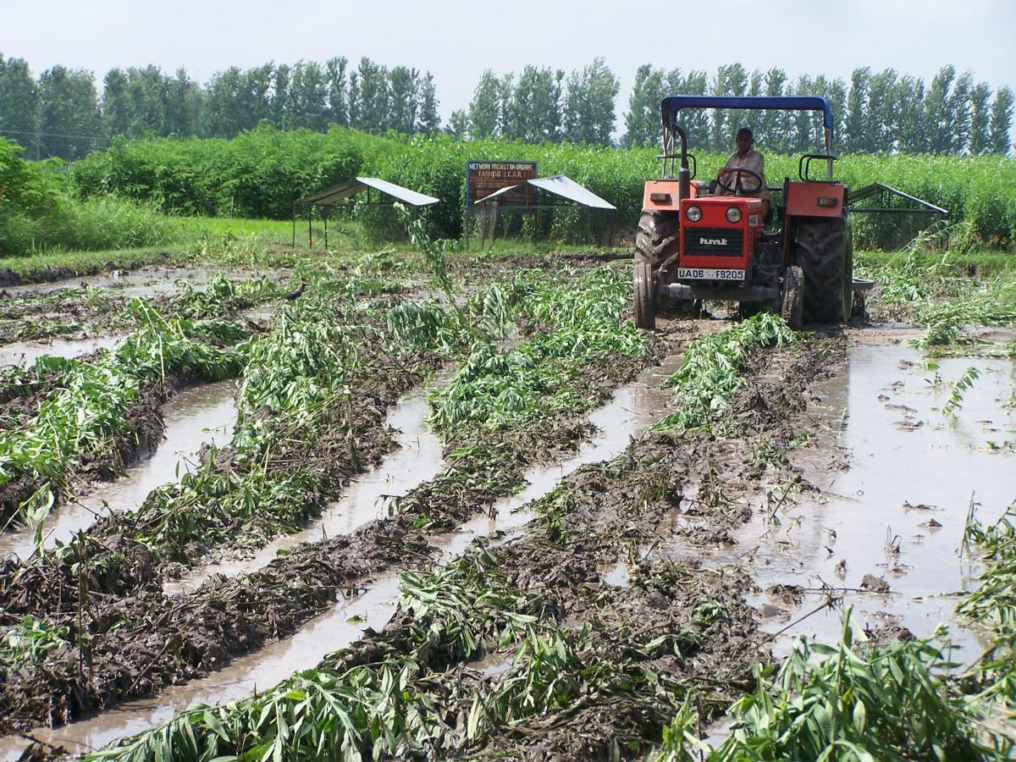
Green manure :
Prior to the sowing of the crop seeds, some plants like sun hemp or guar are grown and then mulched by ploughing them into the soil.
These green plants thus turn into green manure which helps in enriching the soil in nitrogen and phosphorus.
Buried into the soil.

Slide 7
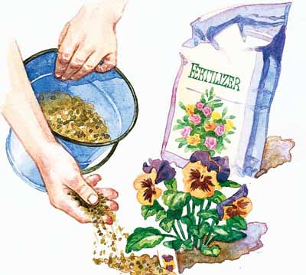
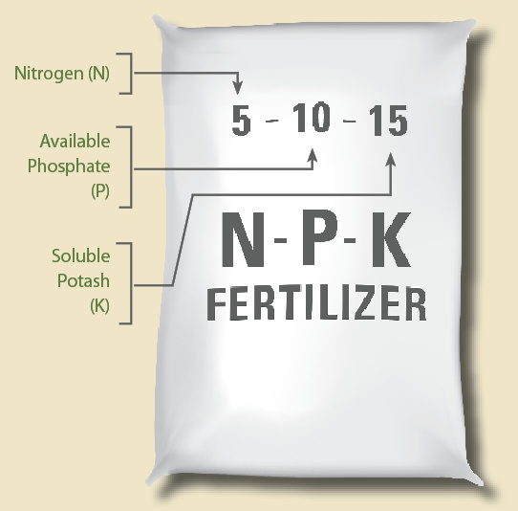
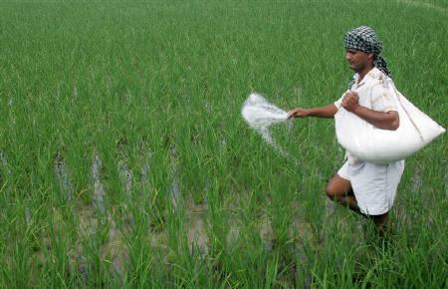
Fertilizers :
Fertilizers are commercially produced plant nutrients.
Fertilizers supply nitrogen, phosphorus and potassium.
They are used to ensure good vegetable growth (leaves, branches and flowers), giving rise to healthy plants.
Fertilizers should be applied carefully in terms of proper does, time, and observing pre and post application precautions for their complete utilisation.

Slide 8
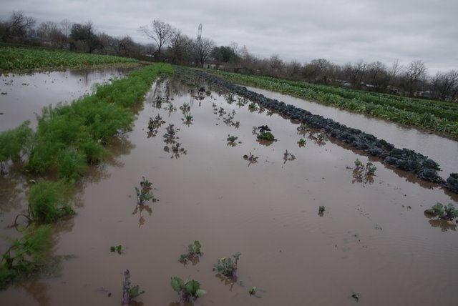
Fertilizers :
For example, sometimes fertilizers get washed away due to excessive irrigation and are not fully absorbed by the plants. This excess fertilizer then leads to water pollution.
Continuous use of fertilizers in an area can destroy soil fertility because the organic matter in the soil is not replenished and micro-organisms in the soil are harmed by the fertilizers used.
Short-term benefits of using fertilizers and long term benefits of using manure for maintaining soil fertility have to be considered while aiming for optimum yields in crop production.

